Slide 1
Lecture-2:
Concept of Addressing
in Network Layer
‹#›
Notes:
‹#›

Slide 2
Lecture Outline:
Internet Addressing
Class-full IP Addressing
Classes and Blocks
Masking
‹#›
Notes:
‹#›

Slide 3
History:
IANA (Internet Assigned Numbers Authority) is responsible for global coordination of the Internet Protocol addressing systems.
Currently there are two types of Internet Protocol (IP) addresses in active use: IP version 4 (IPv4) and IP version 6 (IPv6)
IPv4 was initially deployed on 1 January 1983 and is still the most commonly used version
IPv4 addresses are 32-bit numbers often expressed as 4 octets in "dotted decimal" notation (for example, 192.0.2.53)
‹#›
Notes:
‹#›

Slide 4
IP Addressing v6:
Deployment of the IPv6 protocol began in 1999.
IPv6 addresses are 128-bit numbers and are conventionally expressed using hexadecimal format
2001:0000:3238:DFE1:0063:0000:0000:FEFB
Even after converting into Hexadecimal format, IPv6 address remains long. IPv6 provides some rules to shorten the address. The rules are as follows:
Rule.1: Discard leading Zero(es):
In Block 5, 0063, the leading two 0s can be omitted, such as (5th block):
2001:0000:3238:DFE1:63:0000:0000:FEFB
‹#›
Notes:
‹#›

Slide 5
IP Addressing v6:
Rule.2: If two or more blocks contain consecutive zeros, omit them all and replace with double colon sign :: , such as (6th and 7th block):
2001:0000:3238:DFE1:63::FEFB
Consecutive blocks of zeroes can be replaced only once by :: so if there are still blocks of zeroes in the address, they can be shrunk down to a single zero, such as (2nd block):
2001:0:3238:DFE1:63::FEFB
‹#›
Notes:
‹#›

Slide 6
IP-Addressing v4
The identifier used in network layer to identify each device connected to the Internet is called the Internet address or IP address.
In IPv4, an IP address is a 32-bit binary address (4-bytes) that uniquely and universally defines the connection of a host or a router to the Internet. (Universal in the sense that the addressing system must be accepted by any host that wants to be connected to Internet).
Each IP address is unique and only defines 1 connection to the Internet.
Two devices on the internet can never have the same address at the same time. (Need 2 separate IP addresses).
Two types of IP addressing: Classful vs. Classless
In classful address, there are Class A, B, C, D & E.
‹#›
Notes:
‹#›

Slide 7
Two common notations:
Binary Notations
10000000 00001100 00001111 00001010
Dotted Decimal Notation
128.12.15.10
‹#›
Notes:
‹#›

Slide 8
Example-1
Change the following IP addresses from binary notation to dotted-decimal notation.
a. 10000001 00001011 00001011 11101111
b. 11111001 10011011 11111011 00001111
Solution
We replace each group of 8 bits with its equivalent decimal number and add dots for separation:
a. 129.11.11.239
b. 249.155.251.15
‹#›
Notes:
‹#›

Slide 9
Example-2
Change the following IP addresses from dotted-decimal notation to binary notation.
a. 111.56.45.78
b. 75.45.34.78
Solution
We replace each decimal number with its binary equivalent:
a. 01101111 00111000 00101101 01001110
b. 01001011 00101101 00100010 01001110
‹#›
Notes:
‹#›

Slide 10

Classful IP Addressing
Note:
In classful addressing, the address space is divided into five classes: A, B, C, D, and E.

Slide 11
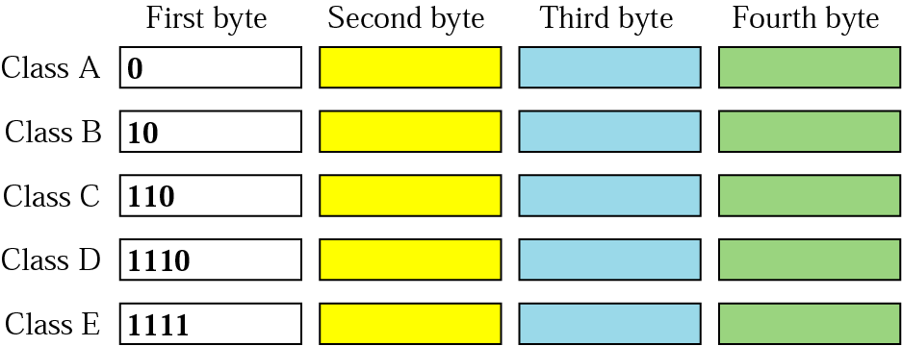
Finding the class in binary notation

Slide 12
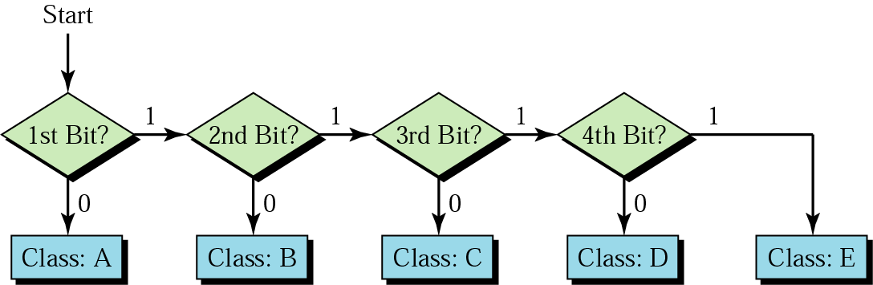
Finding the address class

Slide 13
Example 3
Find the class of each address:
a. 00000001 00001011 00001011 11101111
b. 11110011 10011011 11111011 00001111
Solution
See the procedure in Figure 19.11.
a. The first bit is 0; this is a class A address.
b. The first 4 bits are 1s; this is a class E address.

Slide 14
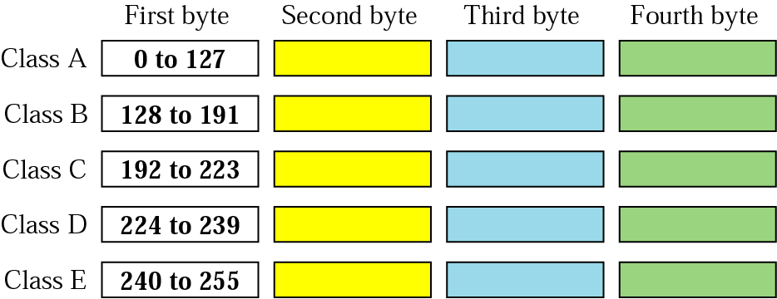
Finding the Class in decimal Notation

Slide 15
Example 4
Find the class of each address:
a. 227.12.14.87
b. 252.5.15.111
c. 134.11.78.56
Solution
a. The first byte is 227 (between 224 and 239). The class is D.
b. The first byte is 252 (between 240 and 255). The class is E.
c. The first byte is 134 (between 128 and 191). The class is B.

Slide 16
Classful Addressing
Unicast address: one source to one destination; Class A, B & C.
Multicast address: one source to a group of destination: only as destination address not source address; Class-D.
IP addresses in class A, B, C are divided into different length of:
Network-ID (netid) and Host-ID (hostid)
When Internet addresses were standardized (early 1980s), the Internet address space was divided up into classes:
– Class A: Network prefix is 8 bits long
– Class B: Network prefix is 16 bits long
– Class C: Network prefix is 24 bits long
‹#›
Notes:
‹#›

Slide 17
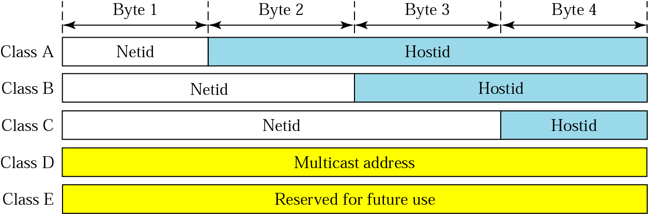
Netid and Hostid

Slide 18
Classful Addressing
Concept of Classes and Blocks (networks): - for example:
In class-A, 1st block covers from 0.0.0.0 to 0.255.255.255 (net-ID 0)
2nd block covers from 1.0.0.0 to 1.255.255.255 (net-ID 1)
last block covers from 127.0.0.0 to 127.255.255.255 (net-ID 127)
Note that: block = class + netid + hostid
One problem with classful addressing is that each class is divided into a fixed number of blocks with fixed size.
Plenty of IP addresses wasted!!! in classful addressing method.
‹#›
Notes:
‹#›

Slide 19
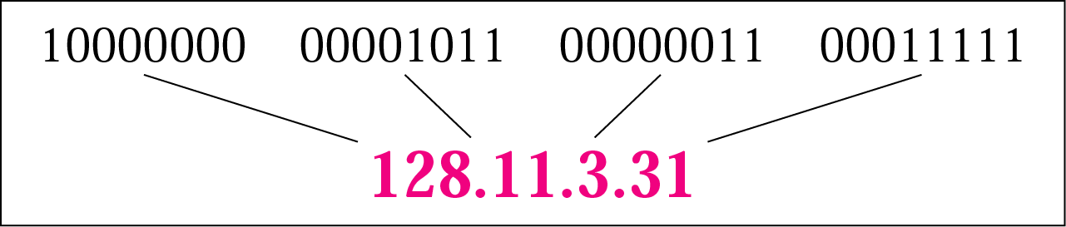
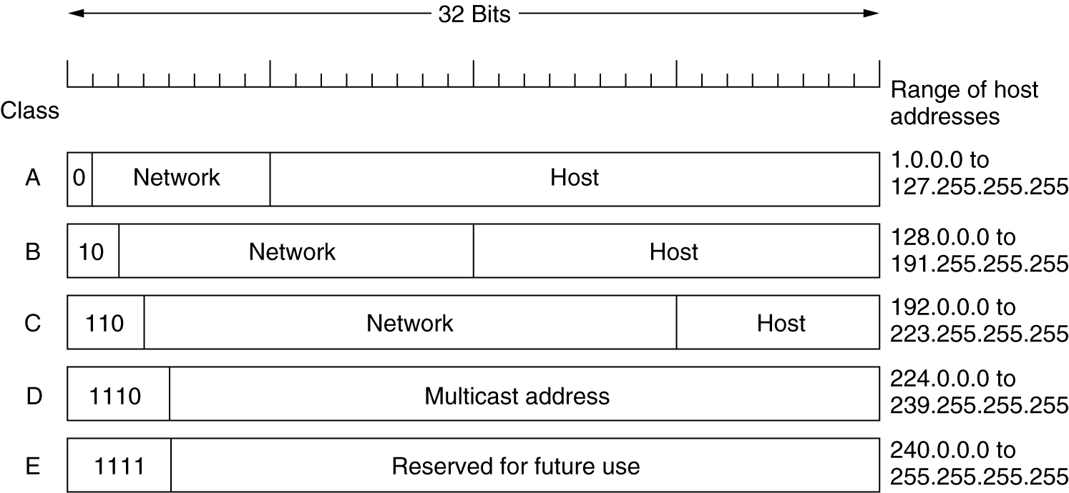
IP Addresses
Unicast
Multi-cast
‹#›
Notes:
‹#›

Slide 20
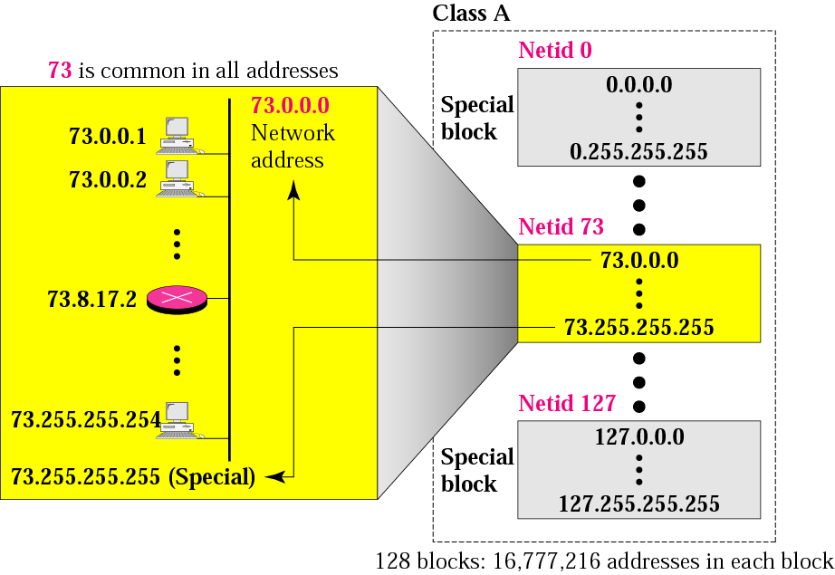
128 Blocks in class A
1st IP used to identify organisation to the rest of Internet
3 bytes = 2²⁴
Last IP reserved for special purpose; not allowed to use
‹#›
Millions of class A addresses are wasted.
Notes:
‹#›
1st address of a block: network address
Last address of a block: broadcast address

Slide 21
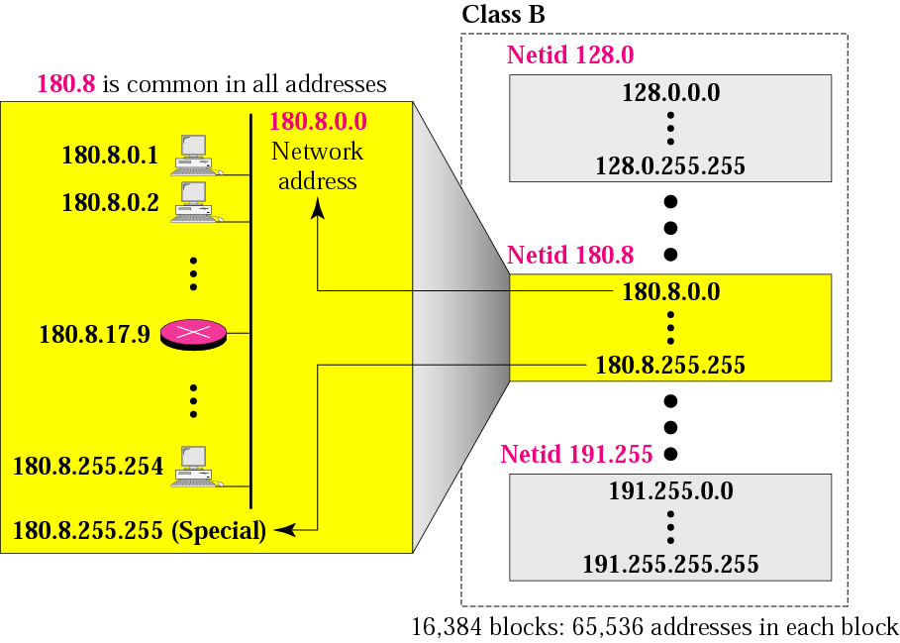
16384 Blocks in class B
16 blocks for private addresses leaving 16368 blocks
Class B for mid size organisation. 16384 organizations are class-B
‹#›
Many of class B addresses are wasted.
Notes:
‹#›

Slide 22
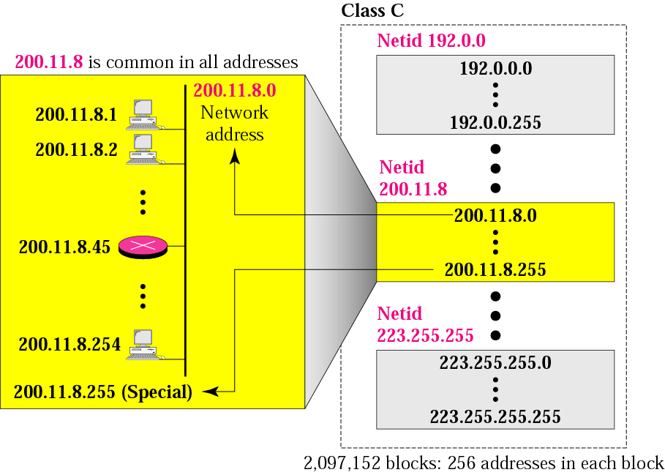
2,097,152 Blocks in class C
256 blocks for private addresses leaving 2,096,896 blocks
Class C for small organisation. Limited IP address in each blocks, which is smaller than the needs of most organisations
‹#›
Notes:
‹#›

Slide 23
Class D addresses are used for multicasting; there is only one block in this class.
Class E addresses are reserved for special purposes; most of the block is wasted.
‹#›
Notes:
‹#›

Slide 24
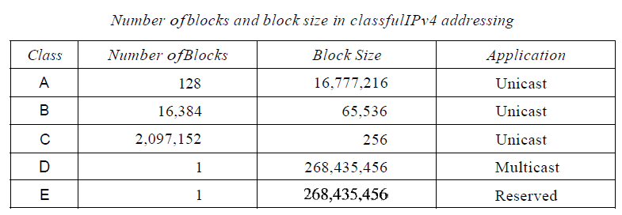
‹#›
Notes:
‹#›

Slide 25
Network Addresses
The network address is the first address.
The network address defines the network to the rest of the Internet.
Given the network address, we can find the class of the address, the block, and the range of the addresses in the block
‹#›
Notes:
‹#›

Slide 26
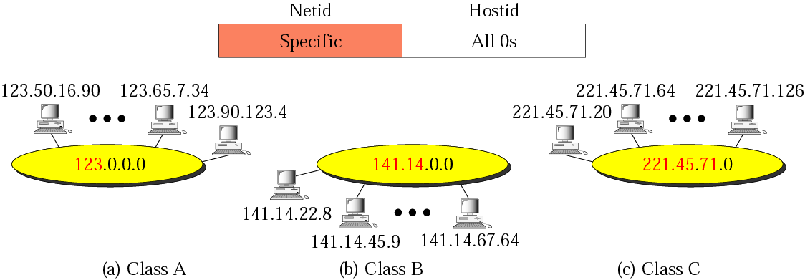
Network addresses
Figure 4-13
In classful addressing, the network address (the first address in the block) is the one that is assigned to the organization.
‹#›
Notes:
‹#›

Slide 27
Example
Given the network address 17.0.0.0, find the class, the block, and the range of the addresses.
Solution
The class is A because the first byte is between 0 and 127.
The block has a netid of 17.
The addresses range from 17.0.0.0 to 17.255.255.255.
‹#›
Notes:
‹#›

Slide 28
Example
Given the network address 132.21.0.0, find the class, the block, and the range of the addresses.
Solution
The class is B because the first byte is between 128 and 191.
The block has a netid of 132.21.
The addresses range: 132.21.0.0 to 132.21.255.255.
‹#›
Notes:
‹#›

Slide 29
Example
Given the network address 220.34.76.0, find the class, the block, and the range of the addresses.
Solution
The class is C because the first byte is between 192 and 223. The block has a netid of 220.34.76.
The addresses range from 220.34.76.0 to 220.34.76.255.
‹#›
Notes:
‹#›

Slide 30
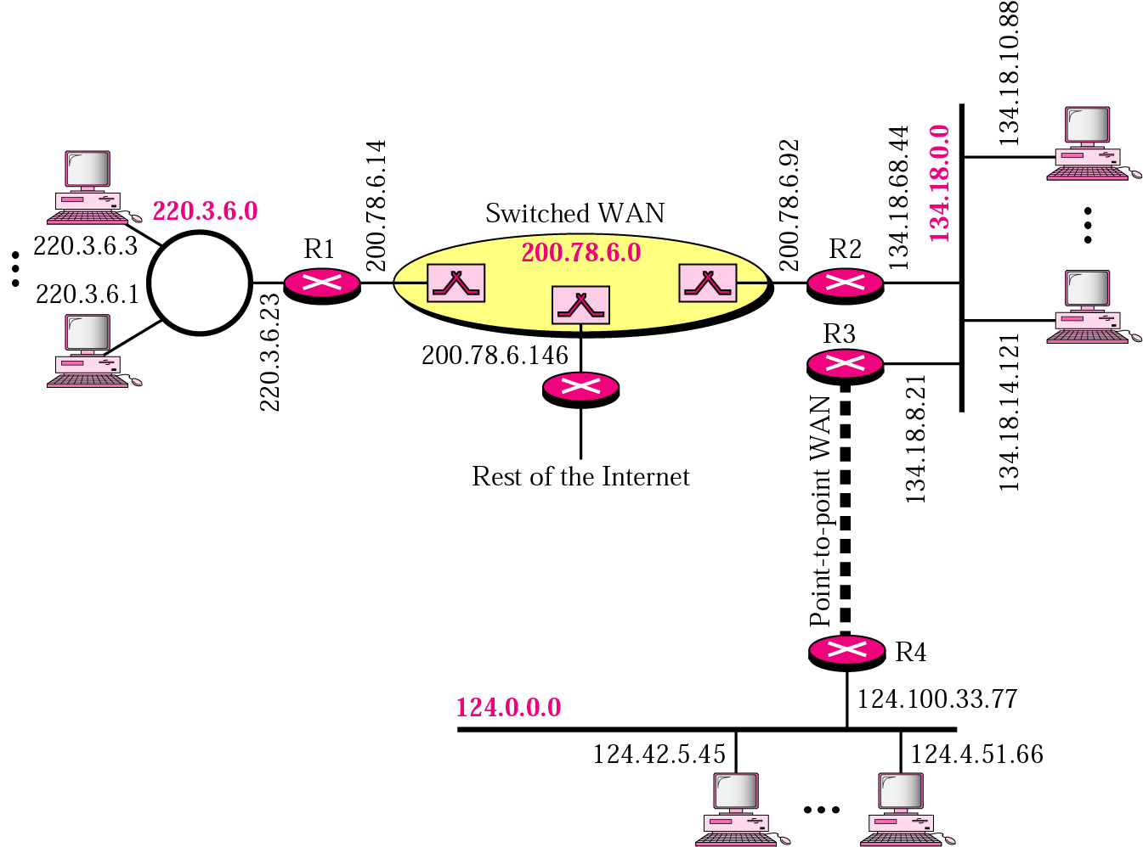
Sample Internet
Note: When it comes to routing, the outside world recognises the network via network address, not the individual host-IPs
‹#›
Notes:
‹#›

Slide 31
Network Addresses
The network address is the beginning address of each block. It can be found by applying the default mask to any of the IP addresses in the block. It retains the netid of the block and sets the hostid to zero.
We must not apply the default mask of one class to an address belonging to another class.
‹#›
Notes:
‹#›

Slide 32
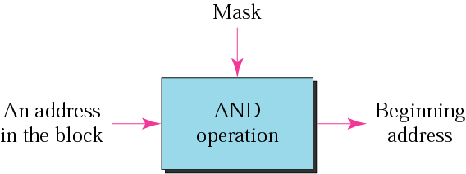
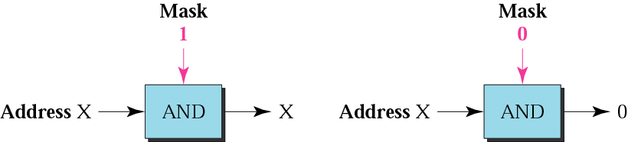
Concept of Masking
A mask is a 32-bit binary number or 4-bytes that gives the first address in the block (the network address) when bitwise ANDed with an address in the block.
‹#›
Notes:
‹#›

Slide 33
Default Mask
Default class A mask is 255.0.0.0
Default class B mask is 255.255.0.0
Default class C mask is 255.255.255.0
‹#›
Notes:
‹#›

Slide 34
Example
Given the address 23.56.7.91 and the default class A mask, find the beginning address (network address).
Solution
The default mask is 255.0.0.0, which means
that only the first byte is preserved
and the other 3 bytes are set to 0s.
The network address is 23.0.0.0.
‹#›
Notes:
‹#›

Slide 35
Example
Given the address 132.6.17.85 and the default class B mask, find network address.
Solution
The default mask is 255.255.0.0, which means
that the first 2 bytes are preserved
and the other 2 bytes are set to 0s.
The network address is 132.6.0.0.
‹#›
Notes:
‹#›

Slide 36
Example
Given the address 201.180.56.5 and the class C default mask, find the network address.
Solution
The default mask is 255.255.255.0,
which means that the first 3 bytes are
preserved and the last byte is set to 0.
The network address is 201.180.56.0.
‹#›
Notes:
‹#›

